Slide 1



Nearly Linear Sparsification of
$ℓ_{p}$ Subspace Approximation
David Woodruff
Taisuke (Tai) Yasuda
→

Slide 2

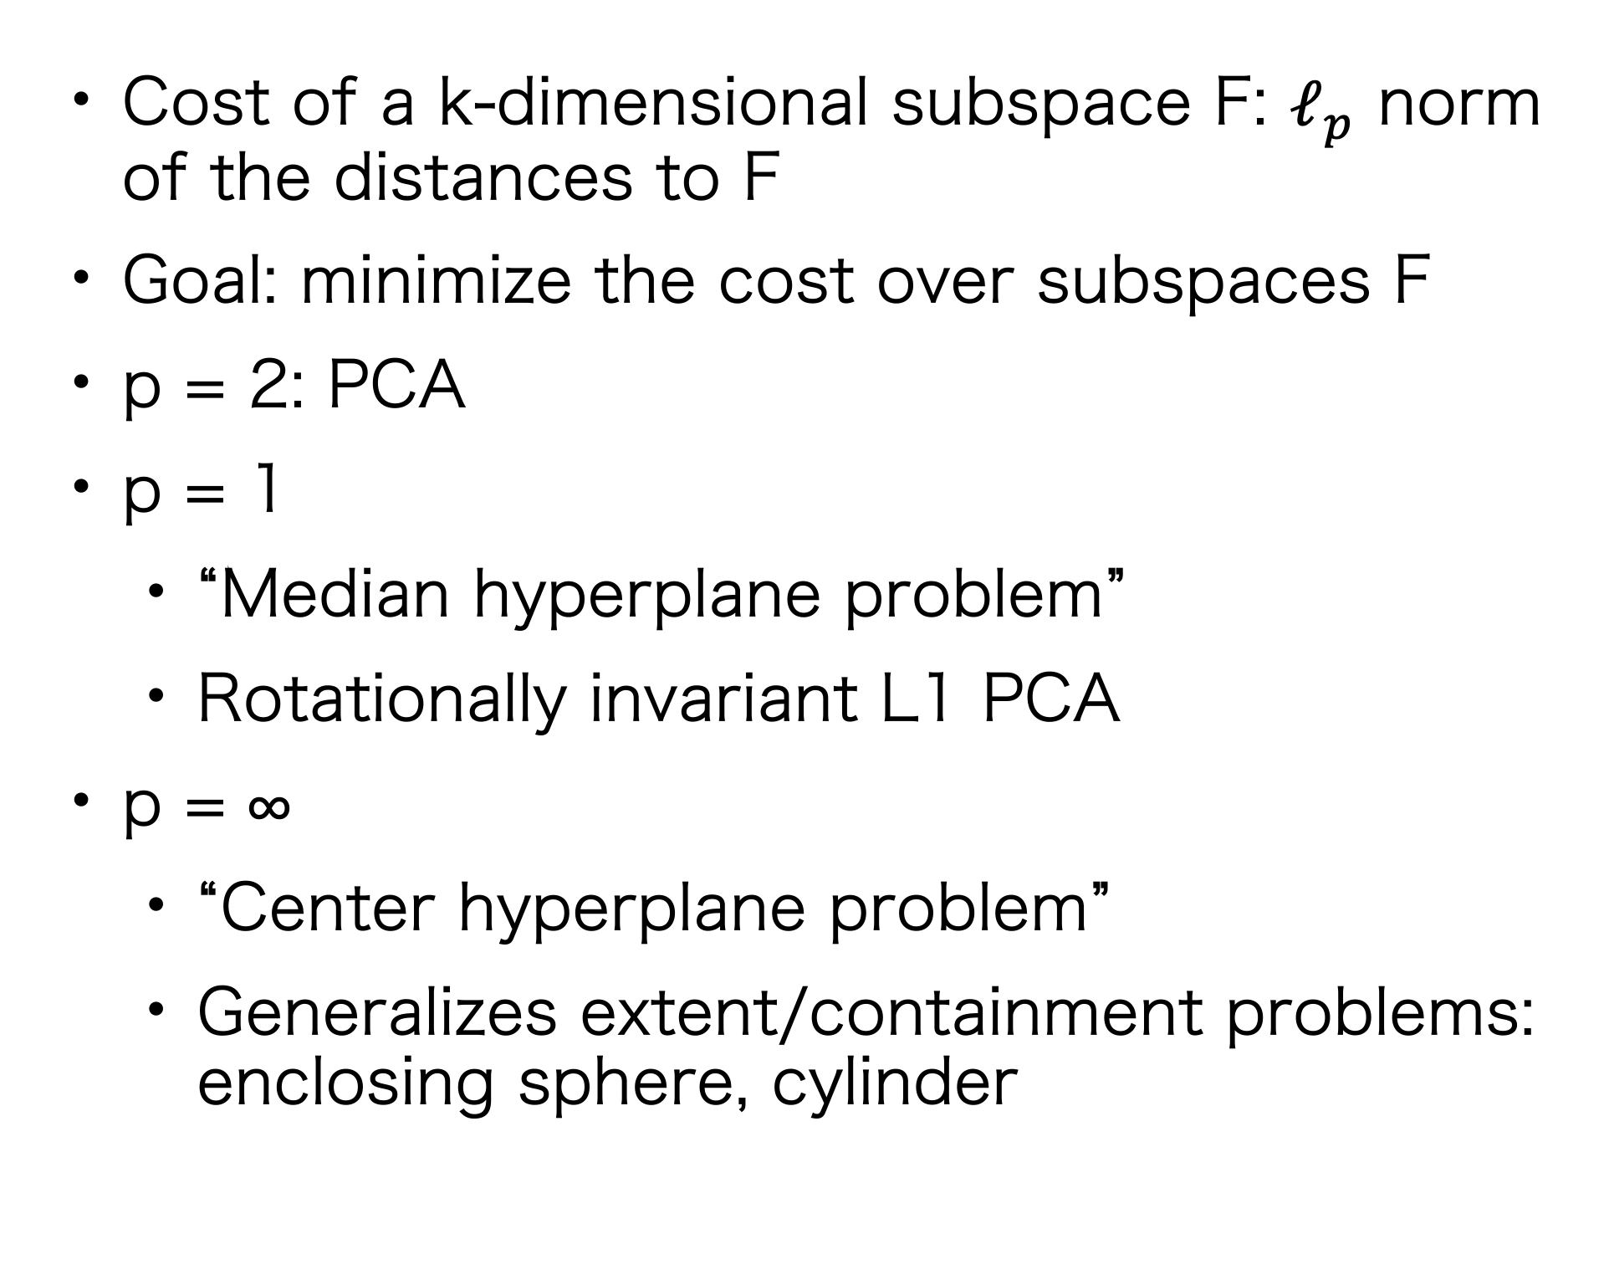
$ℓ_{p}$ Subspace Approximation
Query subspace F of dim k
Cost of a k-dimensional subspace F: $ℓ_{p}$ norm of the distances to F
Goal: minimize the cost over subspaces F
p = 2: PCA
p = 1
“Median hyperplane problem”
Rotationally invariant L1 PCA
p = ∞
“Center hyperplane problem”
Generalizes extent/containment problems: enclosing sphere, cylinder
Euclidean distance to F
n points in d dimensions

Slide 3

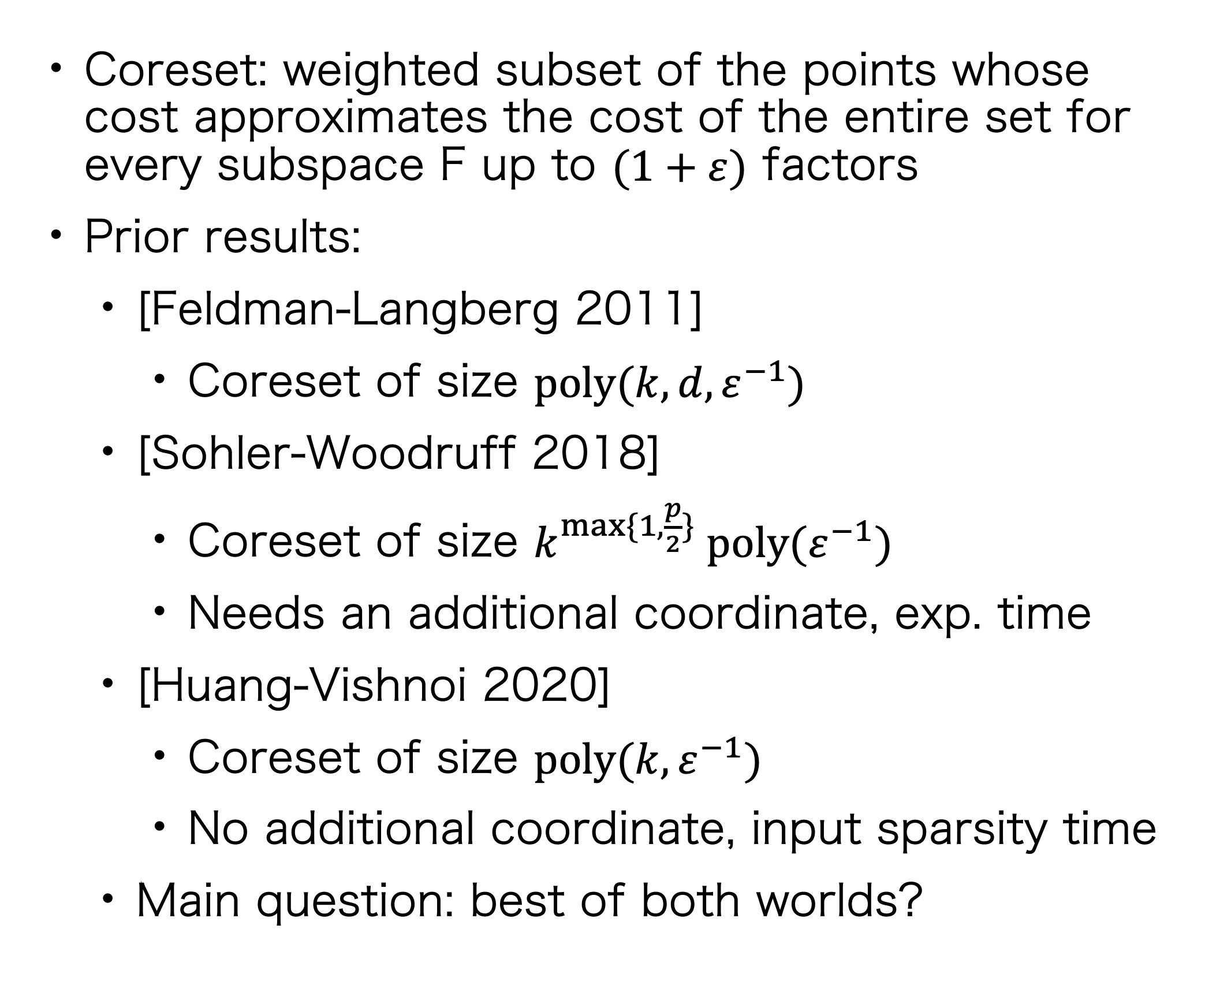
Coresets for $ℓ_{p}$ Subspace Approximation
Query subspace F of dim k
Coreset: weighted subset of the points whose cost approximates the cost of the entire set for every subspace F up to $(1+ε)$ factors
Prior results:
[Feldman-Langberg 2011]
Coreset of size $poly(k,d,ε^{−1})$
[Sohler-Woodruff 2018]
Coreset of size $k^{\max{\{1,\frac{p}{2}\}}} poly(ε^{−1})$
Needs an additional coordinate, exp. time
[Huang-Vishnoi 2020]
Coreset of size $poly(k,ε^{−1})$
No additional coordinate, input sparsity time
Main question: best of both worlds?
Euclidean distance to F
n points in d dimensions

Slide 4
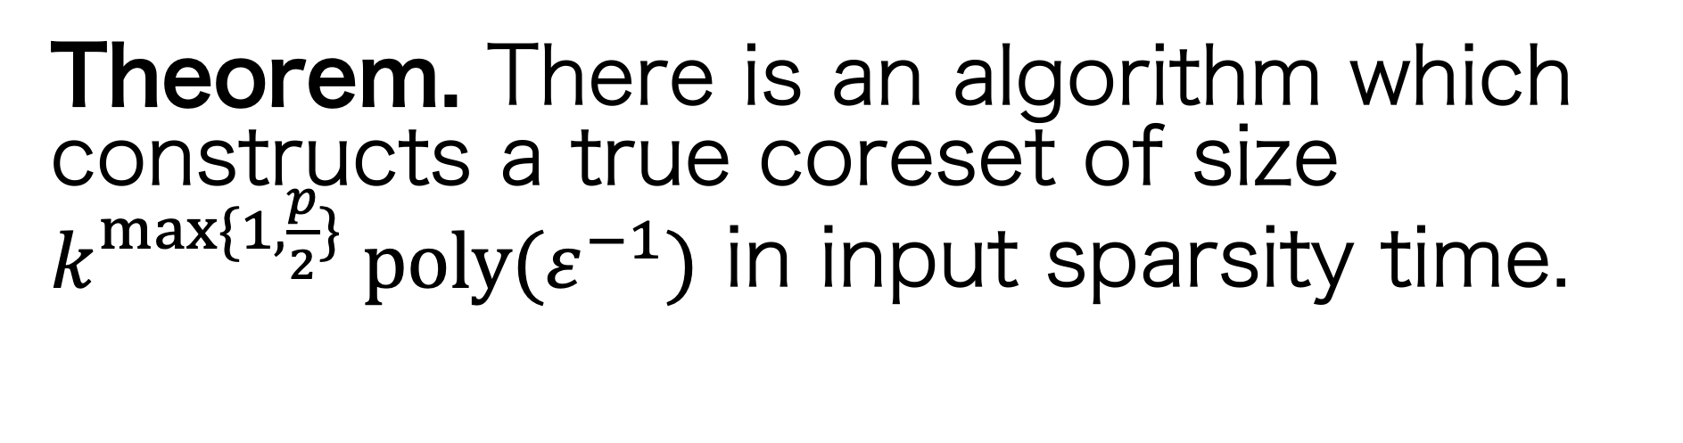
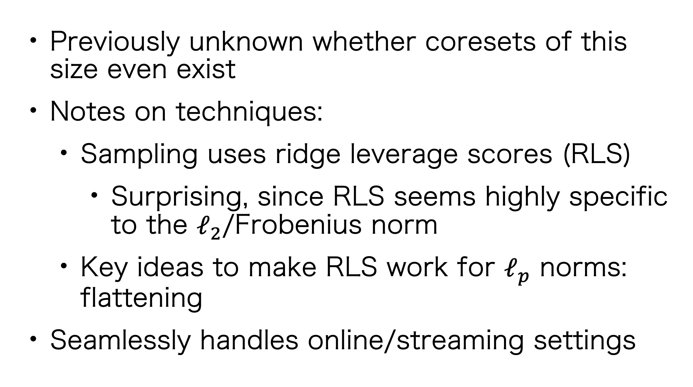
Coresets for $ℓ_{p}$ Subspace Approximation
Query subspace F of dim k
Theorem. There is an algorithm which constructs a true coreset of size $k^{\max{\{1,\frac{p}{2}\}}} poly(ε^{−1})$ in input sparsity time.
Previously unknown whether coresets of this size even exist
Notes on techniques:
Sampling uses ridge leverage scores (RLS)
Surprising, since RLS seems highly specific to the $ℓ_{2}$/Frobenius norm
Key ideas to make RLS work for $ℓ_{p}$ norms: flattening
Seamlessly handles online/streaming settings
Euclidean distance to F
n points in d dimensions

Slide 5
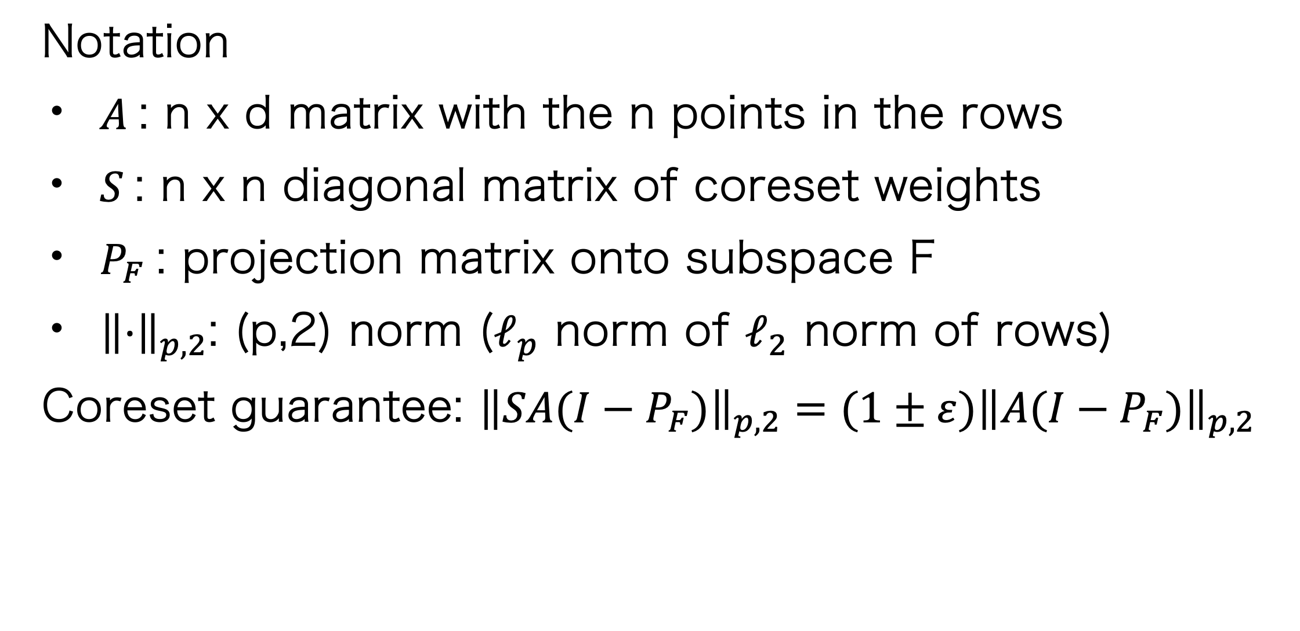
Coresets for $ℓ_{p}$ Subspace Approximation
Query subspace F of dim k
Theorem. There is an algorithm which constructs a true coreset of size $k^{\max{\{1,\frac{p}{2}\}}} poly(ε^{−1})$ in input sparsity time.
Notation
$A$: n x d matrix with the n points in the rows
$S$: n x n diagonal matrix of coreset weights
$P_{F}$: projection matrix onto subspace F
${\left\|⋅\right\|}_{p,2}$: (p,2) norm ($ℓ_{p}$ norm of $ℓ_{2}$ norm of rows)
Coreset guarantee: ${\left\|SA(I−P_{F})\right\|}_{p,2}={(1±ε)\left\|A(I−P_{F})\right\|}_{p,2}$
Euclidean distance to F
n points in d dimensions

Slide 6
Technical Ingredients

Slide 7
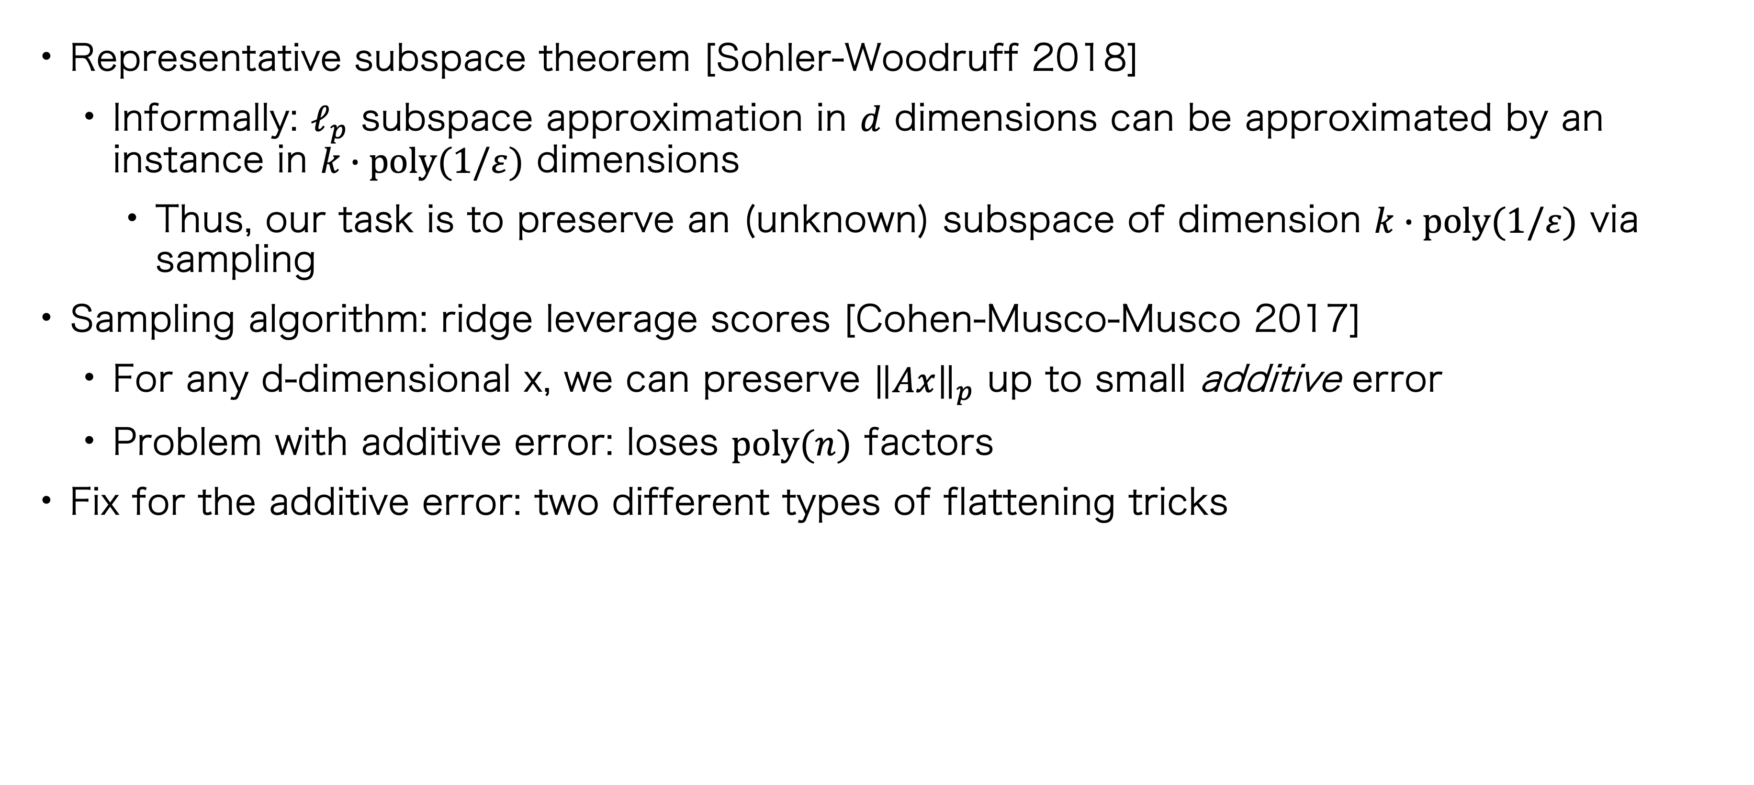
Proof Sketch
Representative subspace theorem [Sohler-Woodruff 2018]
Informally: $ℓ_{p}$ subspace approximation in $d$ dimensions can be approximated by an instance in $k∙poly(1/ε)$ dimensions
Thus, our task is to preserve an (unknown) subspace of dimension $k∙poly(1/ε)$ via sampling
Sampling algorithm: ridge leverage scores [Cohen-Musco-Musco 2017]
For any d-dimensional x, we can preserve ${\left\|Ax\right\|}_{p}$ up to small additive error
Problem with additive error: loses $poly(n)$ factors
Fix for the additive error: two different types of flattening tricks

Slide 8
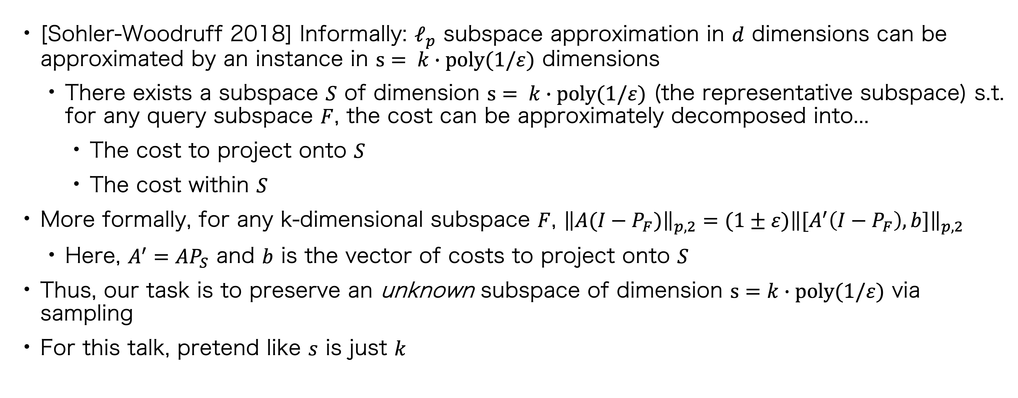
Representative Subspace Theorem
[Sohler-Woodruff 2018] Informally: $ℓ_{p}$ subspace approximation in $d$ dimensions can be approximated by an instance in $s= k∙poly(1/ε)$ dimensions
There exists a subspace $S$ of dimension $s= k∙poly(1/ε)$ (the representative subspace) s.t. for any query subspace $F$, the cost can be approximately decomposed into...
The cost to project onto $S$
The cost within $S$
More formally, for any k-dimensional subspace $F$, ${\left\|A(I−P_{F})\right\|}_{p,2}=(1±ε){\left\|{[A}^{′}\left(I−P_{F}\right), b]\right\|}_{p,2}$
Here, $A^{′}=AP_{S}$ and $b$ is the vector of costs to project onto $S$
Thus, our task is to preserve an unknown subspace of dimension $s=k∙poly(1/ε)$ via sampling
For this talk, pretend like $s$ is just $k$

Slide 9
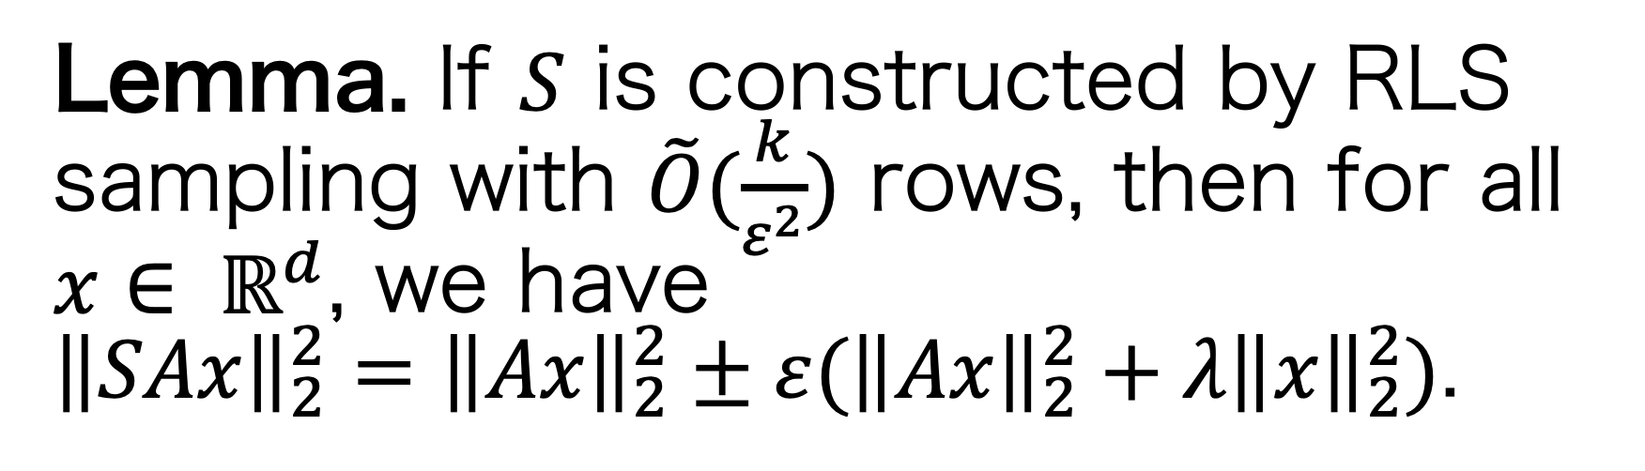
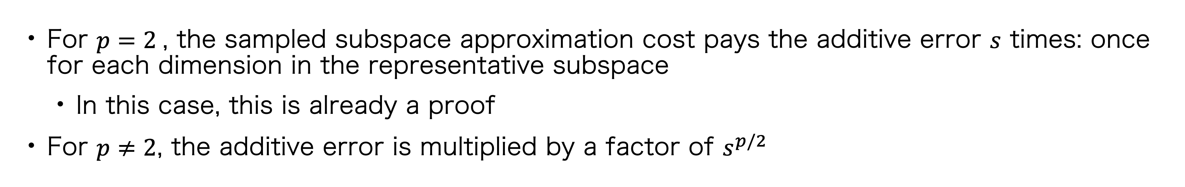
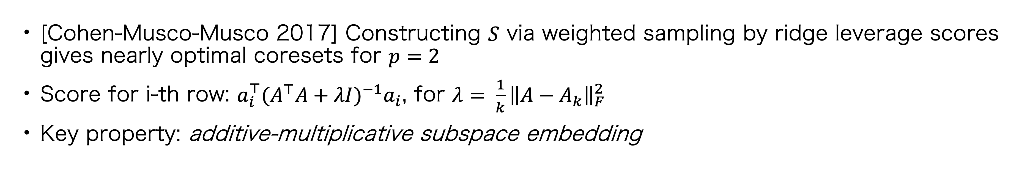


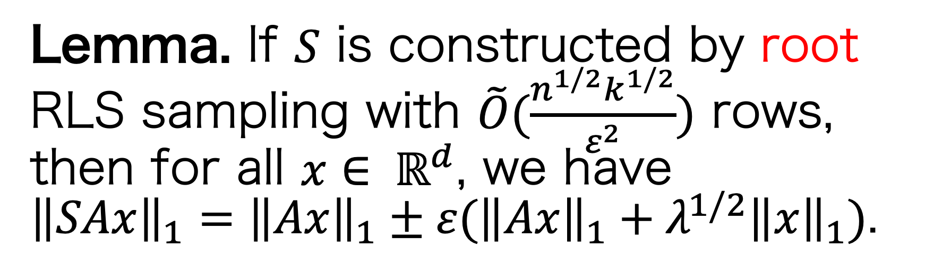
Ridge Leverage Scores
[Cohen-Musco-Musco 2017] Constructing $S$ via weighted sampling by ridge leverage scores gives nearly optimal coresets for $p=2$
Score for i-th row: $a_{i}^{⊤}{(A^{⊤}A+λI)}^{−1}a_{i}$, for $λ= \frac{1}{k}{\left\|A−A_{k}\right\|}_{F}^{2}$
Key property: additive-multiplicative subspace embedding
$$p=2$$
$$p=1$$
Lemma. If $S$ is constructed by RLS sampling with $\tilde{O}(\frac{k}{ε^{2}})$ rows, then for all $x∈ ℝ^{d}$, we have
${\left\|SAx\right\|}_{2}^{2}={\left\|Ax\right\|}_{2}^{2}±ε({\left\|Ax\right\|}_{2}^{2}+λ{\left\|x\right\|}_{2}^{2})$.
Lemma. If $S$ is constructed by root RLS sampling with $\tilde{O}(\frac{n^{1/2}k^{1/2}}{ε^{2}})$ rows, then for all $x∈ ℝ^{d}$, we have
${\left\|SAx\right\|}_{1}={\left\|Ax\right\|}_{1}±ε({\left\|Ax\right\|}_{1}+λ^{1/2}{\left\|x\right\|}_{1})$.
For $p=2$, the sampled subspace approximation cost pays the additive error $s$ times: once for each dimension in the representative subspace
In this case, this is already a proof
For $p≠2$, the additive error is multiplied by a factor of $s^{p/2}$

Slide 10
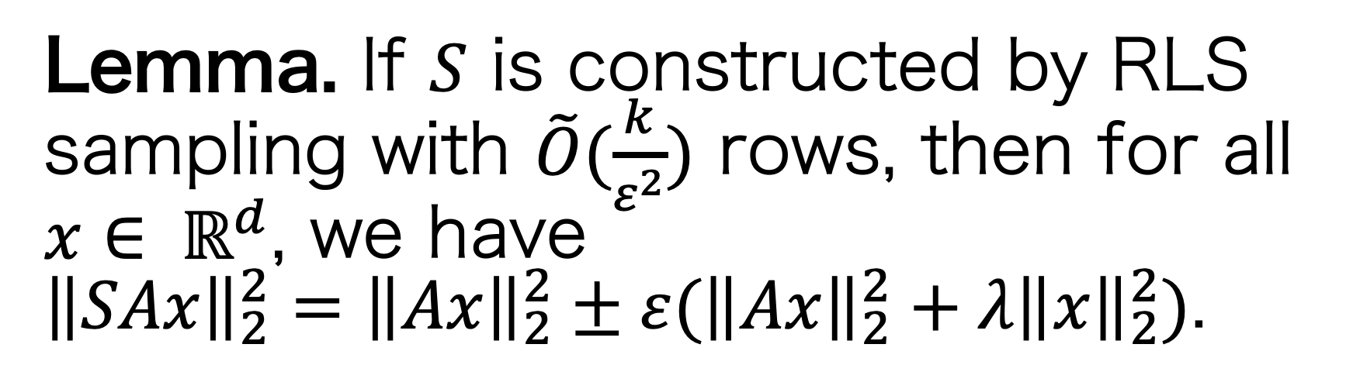
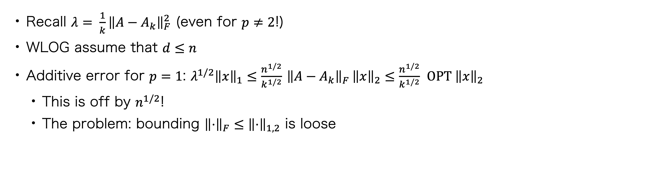

Problems with the Additive Error: p < 2
$$p=2$$
$$p=1$$
Lemma. If $S$ is constructed by RLS sampling with $\tilde{O}(\frac{k}{ε^{2}})$ rows, then for all $x∈ ℝ^{d}$, we have
${\left\|SAx\right\|}_{2}^{2}={\left\|Ax\right\|}_{2}^{2}±ε({\left\|Ax\right\|}_{2}^{2}+λ{\left\|x\right\|}_{2}^{2})$.
Lemma. If $S$ is constructed by root RLS sampling with $\tilde{O}(\frac{n^{1/2}k^{1/2}}{ε^{2}})$ rows, then for all $x∈ ℝ^{d}$, we have
${\left\|SAx\right\|}_{1}={\left\|Ax\right\|}_{1}±ε({\left\|Ax\right\|}_{1}+λ^{1/2}{\left\|x\right\|}_{1})$.
Recall $λ= \frac{1}{k}{\left\|A−A_{k}\right\|}_{F}^{2}$ (even for $p≠2$!)
WLOG assume that $d≤n$
Additive error for $p=1$: $λ^{1/2}{\left\|x\right\|}_{1}≤\frac{n^{1/2}}{k^{1/2}}$ ${\left\|A−A_{k}\right\|}_{F}^{}{\left\|x\right\|}_{2}≤\frac{n^{1/2}}{k^{1/2}} OPT {\left\|x\right\|}_{2}$
This is off by $n^{1/2}$!
The problem: bounding ${\left\|⋅\right\|}_{F}≤{\left\|⋅\right\|}_{1,2}$ is loose

Slide 11
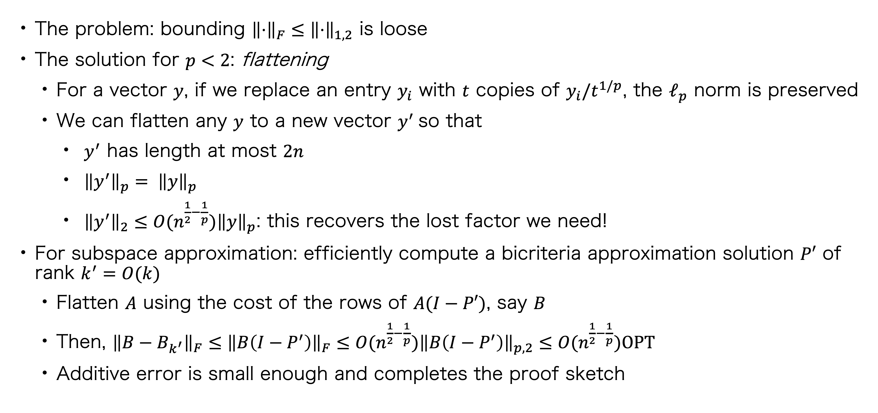
Problems with the Additive Error: p < 2
The problem: bounding ${\left\|⋅\right\|}_{F}≤{\left\|⋅\right\|}_{1,2}$ is loose
The solution for $p<2$: flattening
For a vector $y$, if we replace an entry $y_{i}$ with $t$ copies of $y_{i}/t^{1/p}$, the $ℓ_{p}$ norm is preserved
We can flatten any $y$ to a new vector $y^{′}$so that
$y^{′}$ has length at most $2n$
${\left\|y^{′}\right\|}_{p}= {\left\|y\right\|}_{p}$
${\left\|y^{′}\right\|}_{2}≤O(n^{\frac{1}{2}−\frac{1}{p}}){\left\|y\right\|}_{p}$: this recovers the lost factor we need!
For subspace approximation: efficiently compute a bicriteria approximation solution $P′$ of rank $k^{′}=O(k)$
Flatten $A$ using the cost of the rows of $A(I−P′)$, say $B$
Then, ${\left\|B−B_{k^{′}}\right\|}_{F}≤{\left\|B\left(I−P^{′}\right)\right\|}_{F}≤O(n^{\frac{1}{2}−\frac{1}{p}}){\left\|B\left(I−P^{′}\right)\right\|}_{p,2}≤O(n^{\frac{1}{2}−\frac{1}{p}})OPT$
Additive error is small enough and completes the proof sketch

Slide 12
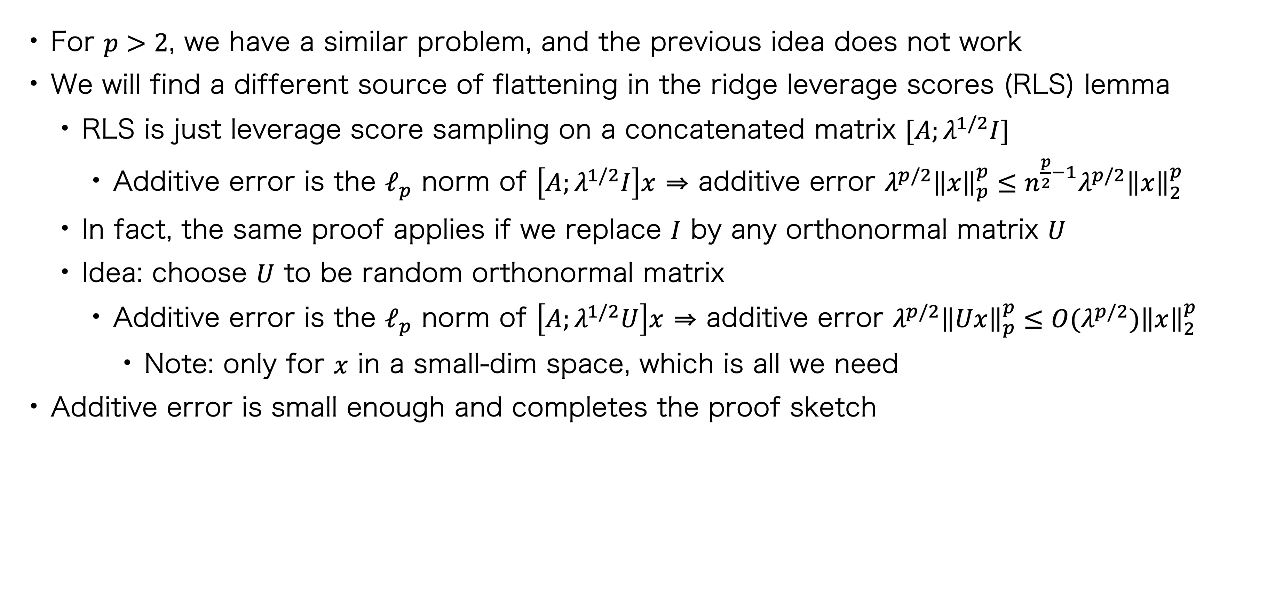
Problems with the Additive Error: p > 2
For $p>2$, we have a similar problem, and the previous idea does not work
We will find a different source of flattening in the ridge leverage scores (RLS) lemma
RLS is just leverage score sampling on a concatenated matrix $[A;λ^{1/2}I]$
Additive error is the $ℓ_{p}$ norm of $\left[A;λ^{1/2}I\right]x$ ⇒ additive error $λ^{p/2}{\left\|x\right\|}_{p}^{p}≤n^{\frac{p}{2}−1}λ^{p/2}{\left\|x\right\|}_{2}^{p}$
In fact, the same proof applies if we replace $I$ by any orthonormal matrix $U$
Idea: choose $U$ to be random orthonormal matrix
Additive error is the $ℓ_{p}$ norm of $\left[A;λ^{1/2}U\right]x$ ⇒ additive error $λ^{p/2}{\left\|Ux\right\|}_{p}^{p}≤O(λ^{p/2}{)\left\|x\right\|}_{2}^{p}$
Note: only for $x$ in a small-dim space, which is all we need
Additive error is small enough and completes the proof sketch

Slide 13
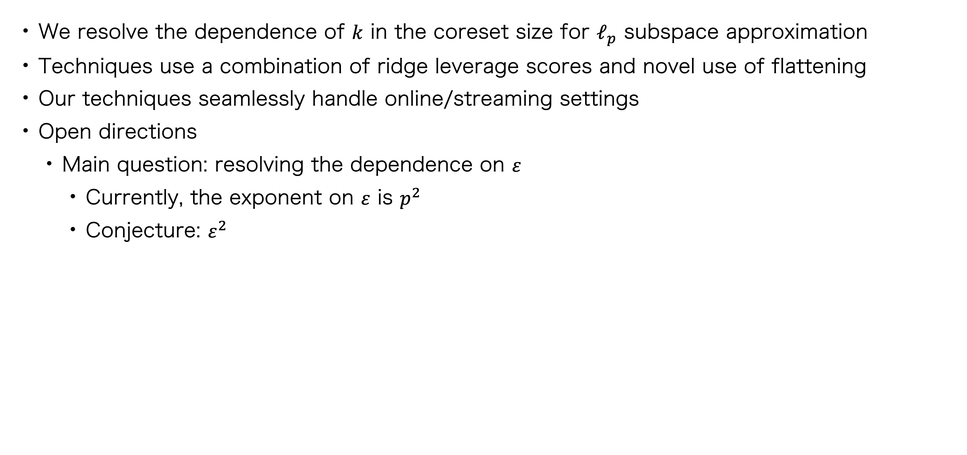
Conclusion
We resolve the dependence of $k$ in the coreset size for $ℓ_{p}$ subspace approximation
Techniques use a combination of ridge leverage scores and novel use of flattening
Our techniques seamlessly handle online/streaming settings
Open directions
Main question: resolving the dependence on $ε$
Currently, the exponent on $ε$ is $p^{2}$
Conjecture: $ε^{2}$

